Slide 1
Excel Final Assessment
Yuvan Barathi C

Slide 2
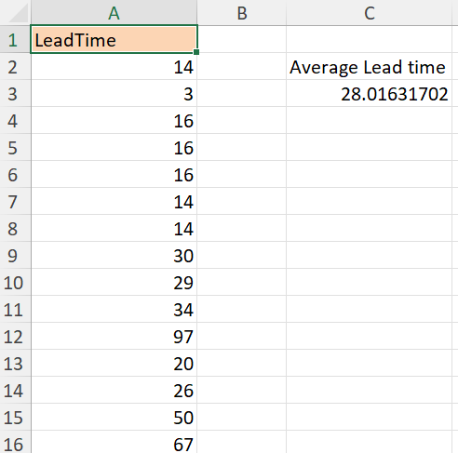
Case study -1
The average lead time for all work orders is calculated using AVERAGE function.

Slide 3
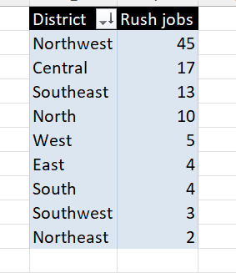
Case study -2
Using Pivot table it is observed that Northwest has the highest number of rush jobs.

Slide 4
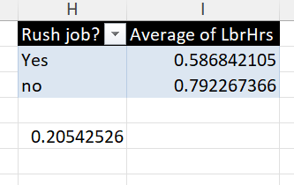
Case study -3
When the job is not rushed the average of labour hours is increasing. Hence the difference is calculated as shown above.

Slide 5
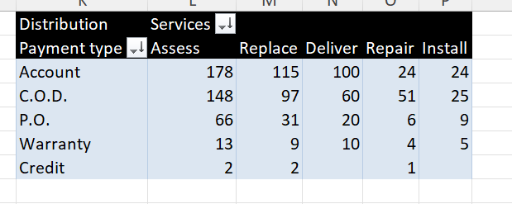
Case study -4
From the results of pivot table, it is observable that the “Assess” service is highly demanded across all the payment types. Credit is the least used type of payment.

Slide 6
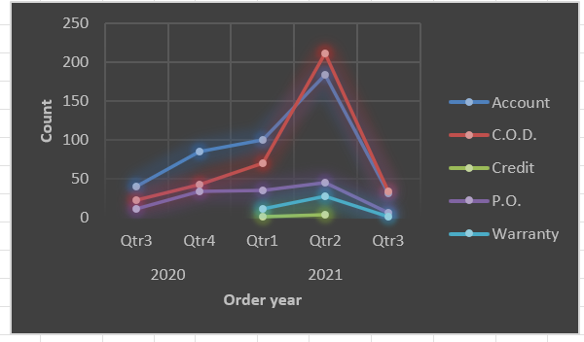
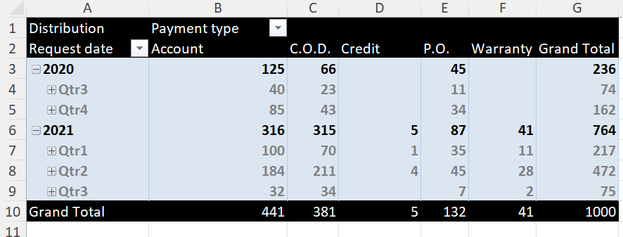
Case study -5
Certain payment types like account, p.o and c.o.d show significant trends till the Quarter 2 of 2021 and the trend disappears progressively. Rest of the Payment types don’t show a significant trend.

Slide 7
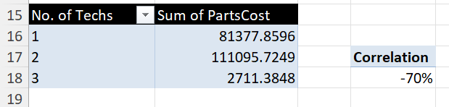
Case study -6
The correlation between the number of techs and parts cost is observed to be high by using the formula CORREL.

Slide 8
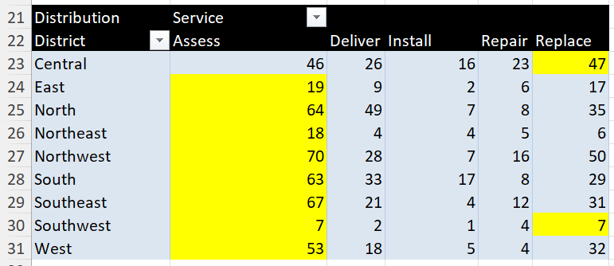
Case study -7
Except one District, all the other districts request the service of “Assess” the most compared to other services.

Slide 9
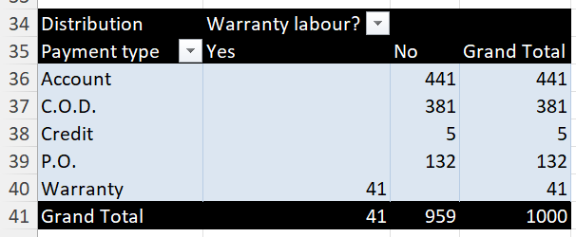
Case study -8
When there is no warranty labour the people prefer every payment type other than warranty. When warranty labour exists, people prefer warranty payment type.

Slide 10
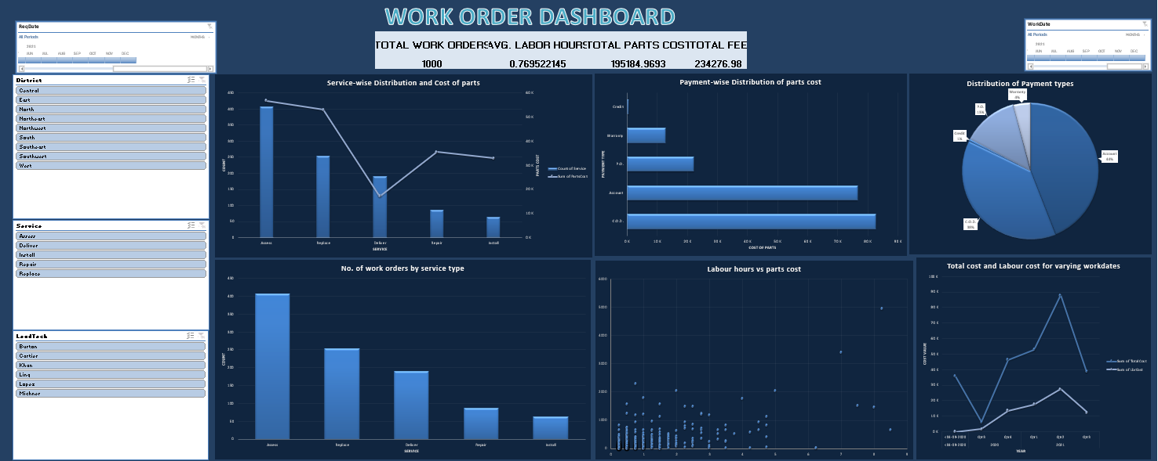
DASHBOARD

